Slide 1
NCDA Annual Conference SESSION: CDBG Increasing Grantee & Subrecipient Capacity June 12, 2024 McKinney, TX

Slide 2
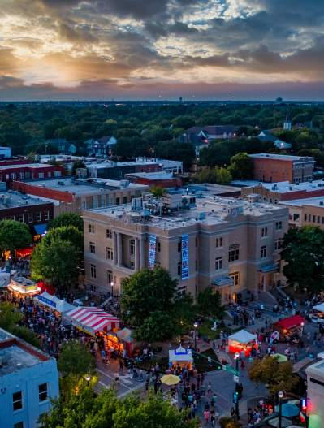
McKinney, Texas is….
One of the fastest growing small cities in the United States
Population of 213,000+ residents
CDBG Entitlement Community since 2024 – celebrating 20 years!
Approximately $940,000 CDBG funding annually
8 CDBG projects funded typically on an annual basis
Housing Rehabilitation Activities, about 12 annually
A Mix of Subrecipients, city-wide
A few economic development or community development activities

Slide 3
Capacity Building Grantee and Subrecipients Program: Assisting Subrecipients to operate efficiently under federal, local and state requirements (regulatory and program) Administrative: Ensure sufficient resources are provided to grantees staff and subrecipients to meet compliance requirements, as well as provide program delivery, in a timely manner.

Slide 4
Capacity Building Subrecipients implement the quality-of-life activities that the grantee cannot on their own, thus creating a partnership (activity + funding). This is a mirrored relationship.

Slide 5
Back to Basics – What is a Subrecipient?
CDBG regulations 24 CFR §570.500(c) define a subrecipient as: a public or private nonprofit agency, authority, or organization, or a for-profit entity authorized under §570.201(o), receiving CDBG funds from the recipient or another subrecipient to undertake eligible activities.
The term excludes an entity receiving CDBG funds from the recipient under the authority of §570.204, unless the grantee explicitly designates it as a subrecipient. Examples: private, nonprofit organizations, community development corporations, school districts, housing authorities, faith-based organizations, as a few examples.

Slide 6
Capacity building block: your agreement
Agreement Content (At Minimum):
Compliance Provisions
Scope of Services (Beneficiaries, Use of Funds, Regulations)
Reimbursement, Expenditure Procedures
Insurance. SAMS.
Reporting Compliance (Monthly? Quarterly?)
General Requirements, Audit Information
Records Compliance
Program Income Guidelines
Income Limits
Schedules
All requirements of your subrecipients,
put it all in the grant agreement.

Slide 7
Capacity building block: your agreement, part II
Record Keeping and Internal Controls
Performance Measurements
Reporting Schedule
Repayment of Grant Funds
Eligible and Ineligible Uses of Funds
Local, State Requirements
All requirements of your subrecipients,
put it all in the grant agreement.

Slide 8
Internal Controls Agency and the Grantee must establish and follow internal controls that provide assurance that the CDBG-funded program is managed in compliance with the local, state and federal requirements.
Risk Assessment
Communication Training
Information
innovation
Cross Check Environment
Monitoring
Don’t Forget Use/Follow HUD Checklists

Slide 9
Subrecipient Monitoring Importance Clear cross-checks are needed, to determine if your methods and training are working and if the subrecipients are following. Best practice for post-risk assessment of the grantee and subrecipient program. Documentation for compliance (program and fiscal) Aids in improvement for program and administrative capacity.

Slide 10
Methods of Monitoring
Subrecipient Reports
Monthly or quarterly, it’s one of the best sources of performance measurement.
Helps the Grantee report In IDIS the goals that both the subrecipient and Grantee has agreed upon.
Indicator that grant agreement obligations and federal requirements are met.
Other
Check-in Chat Timeliness
Client Feedback Engagement

Slide 11
Know who you are grant manager

Slide 12
Grantee CAPACITY BUILDING suggested practices
Simple Processes for Organization
Build Your Internal Relationships!
Cross-Train/
Technical Assistance
Develop Engaging
Partnerships
Risk Assessment
Scale Back When Needed, it’s OK.
Evaluate
Document, Document, Document!

Slide 13
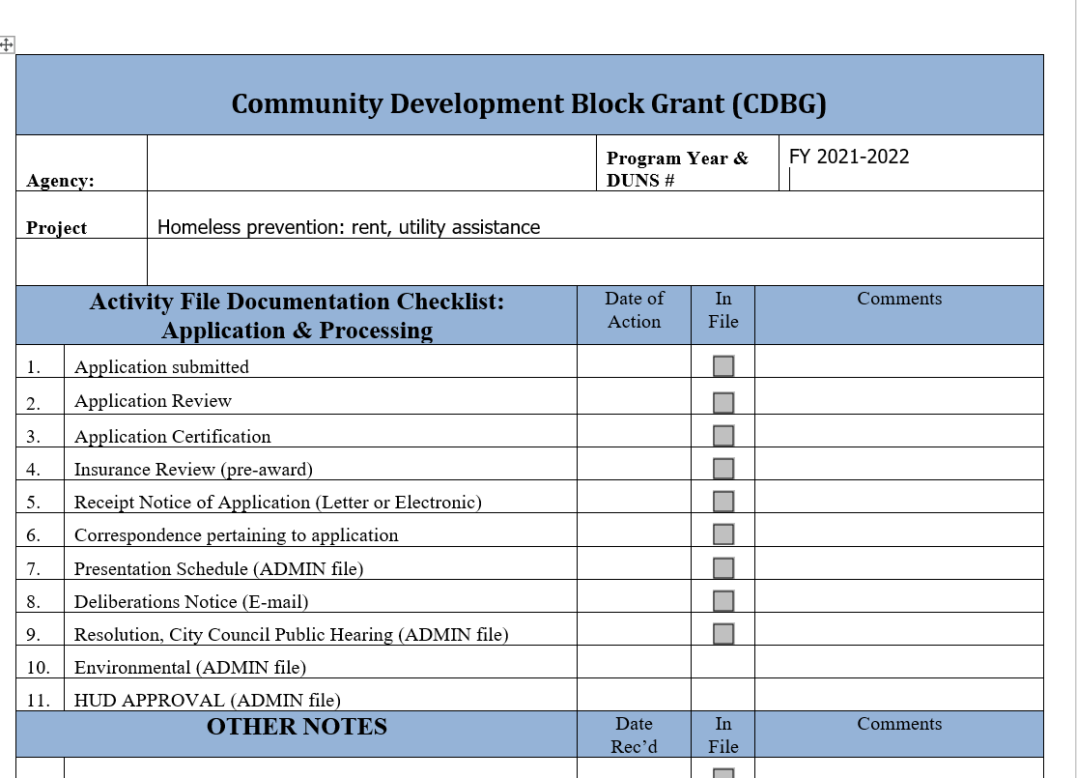
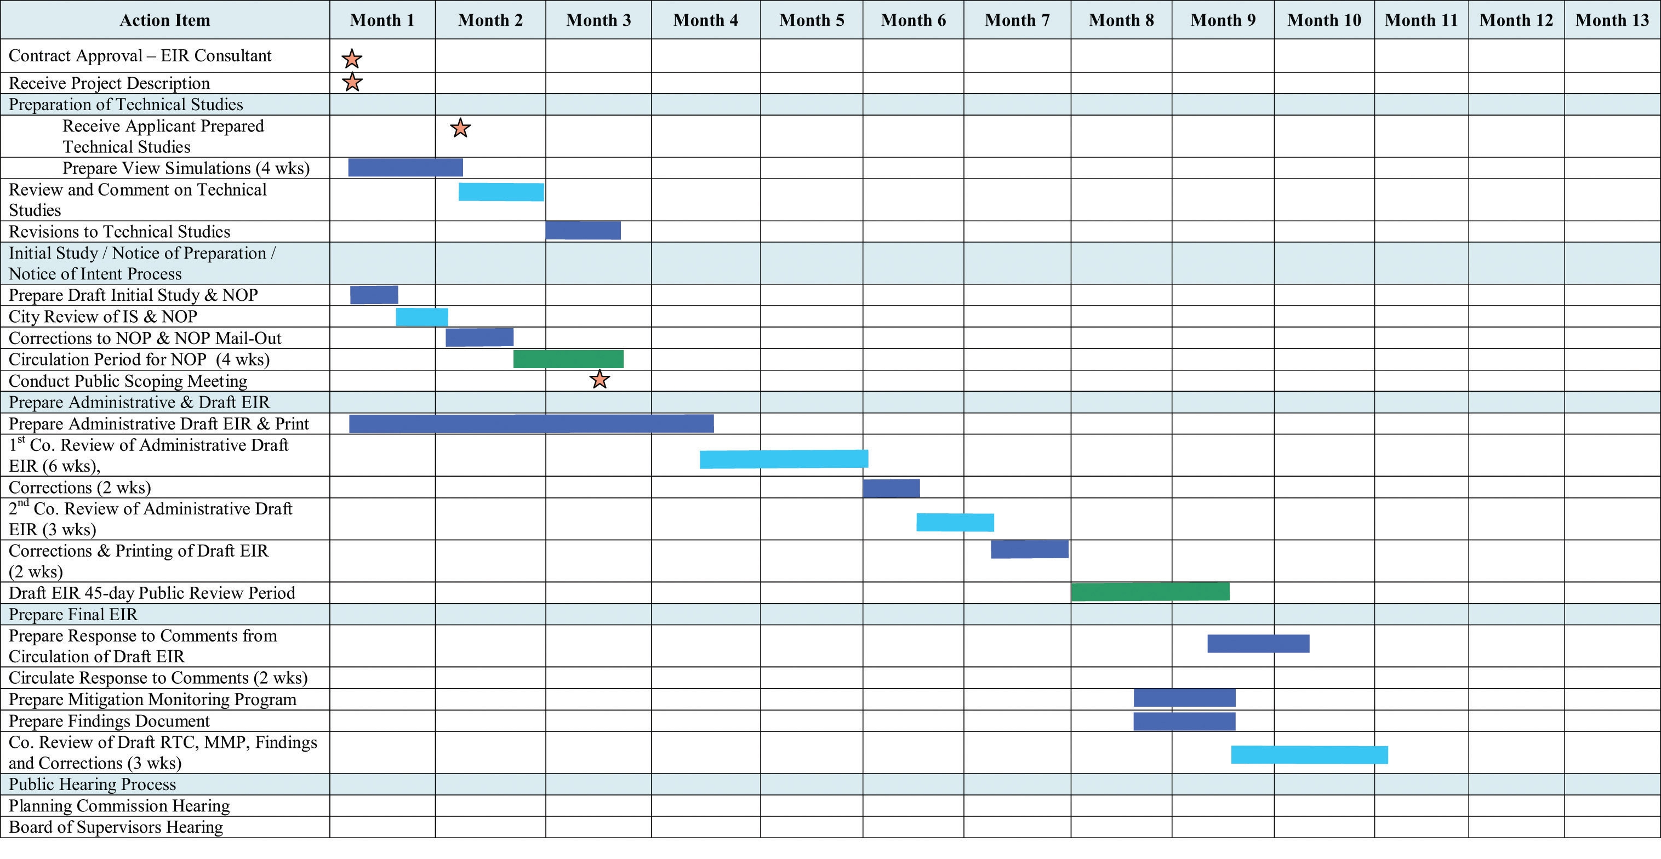
Organize your program and files. Talk with your peers for ideas!
CDBG Subrecipient Monthly Report Tracking for 2021-2022 Program Year
 | Use of Funds | Funding | Goal | Oct | Nov | Dec | Jan | Feb | March | April | May goal 50% | June | July | Aug goal 100% | Sep | Funds spent to date | YTD Annual Avail
Assistance Center of Collin Co. | Homeless prevention: rental, utility assistance | 100 | 100 | 4 | 4 | 0 | 0 | 0 | 7 | 1 | 1 | 13 | 1 | 0 | 4 |  | 35
Reimbursement requested |  | 20,899.00 | 20,899.00 | 2,728.49 | 2,071.67 | - | - | - | 2,159.40 | 862.00 | 1,964.37 | 8,084.63 | 1,248.76 | 0.00 | 1,760.00 | 20,879.32 | (19.68)
 |  |  |  |  |  |  |  | 23% |  |  | 47% |  |  | 91%
 |  |  | Invoice date | 1/11/2022 | 1/11/2022 | 1/11/2022 | N/A | N/A | 4/4/2022 | 5/3/2022 | 6/7/2022 | 7/5/2022 | 8/2/2022 | N/A | 9/23/2022
 |  |  | PO Processed | 1/26/2022 | 1/26/2022 | 1/26/2022 | N/A | N/A | 4/5/2022 | 5/4/2022 | 6/9/2022 | 7/5/2022 | 8/2/2022 | N/A | 9/29/2022

Slide 14
Grantee: Ongoing Technical Assistance YES (Your Essential staff)
Policies and Procedures
Coaching
Corrections where needed
Build trust

Slide 15
Outcomes
Utilize HUD Monitoring Checklists to cross check your internal controls, policies and procedures
Train so that the Grantee and Subrecipient mirror each other –
Document, Document, Document
Ensure that you have effective Internal Controls
Training applies to all – don’t forget to train (or re-train) your own staff (Grantee)
Continue to assess capacity to administer federal funds and programs
(esp. seasoned subrecipients require re-evaluation, as things change)
Innovate – never be afraid to adjust or change!
Give grace, yet correct when needed
Keep building relationships, even with potential agencies that are not funded. Sometimes encouragement is needed

Slide 16
Shirletta Best Community Services Administrator City of McKinney Housing & Community Development Phone: 972-547-7577 sbest@mckinneytexas.org THANK YOU!

